Slide 1
STD-10 Physics
Chapter-10 Current Electricity
Topic – Electric circuit and conductance

Slide 2
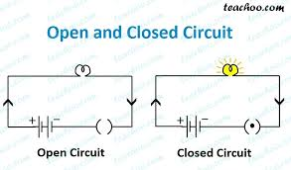
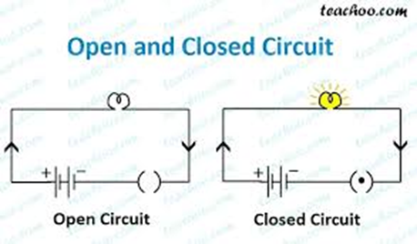
Electric circuit
Definition – A continuous conducting path between the two terminals of a battery (source of electric energy) is called an electric circuit.
Circuit
Closed Circuit
Open Circuit

Slide 3
Closed Circuit: The circuit is called closed when the current flows in the circuit i.e. there is a continuous conducting path between the two terminals of a battery. In a closed circuit, the bulb lights up (as shown in fig. A)
Open Circuit: The circuit is called open when the current flowing in a circuit is zero i.e. there is no continuous connection between the two terminals. In an open circuit, the bulb does not light up (as shown in fig. B).

Slide 4
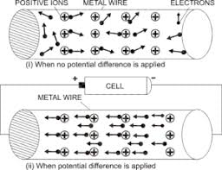
Electric Resistance
When current flows through a conductor, (a metallic wire), the wire offers some obstruction to the flow of current.
Definition: The obstruction offered to the flow of current by the wire (or conductor) is called its resistance.
Cause for Resistance
When there is zero potential difference, the free electron of metal move at random, colliding among themselves and with the fixed positive ions (i.e. the atoms which have lost electrons).

Slide 5
ii. When there is some potential difference across the ends of metallic wire, the electrons inside it start moving from the negative potential towards the positive potential. Due to this, speed of the electrons increase. During their movement, they collide with the fixed positive ions and hence these electrons lose their speed, but due to the existing potential difference, the electrons are again accelerated towards the positive terminal.
These collisions give rise to certain opposition to the drift of electrons.
This opposition is commonly called electric resistance.

Slide 6


Slide 7
Units of resistance:
The S.I unit of resistance is Ohm.
It is denoted by the symbol Ω (Omega).
Higher resistances are commonly measured in:
kilo-ohm, where 1kΩ = 10³ Ω
Mega-ohm, where 1MΩ = 10⁶ Ω
Giga-ohm, where 1GΩ = 10⁹ Ω
One ohm – A conductor is said to have a resistance of one ohm, if a current of 1 A flows through it, when its ends are at a potential difference of 1 V.

Slide 8
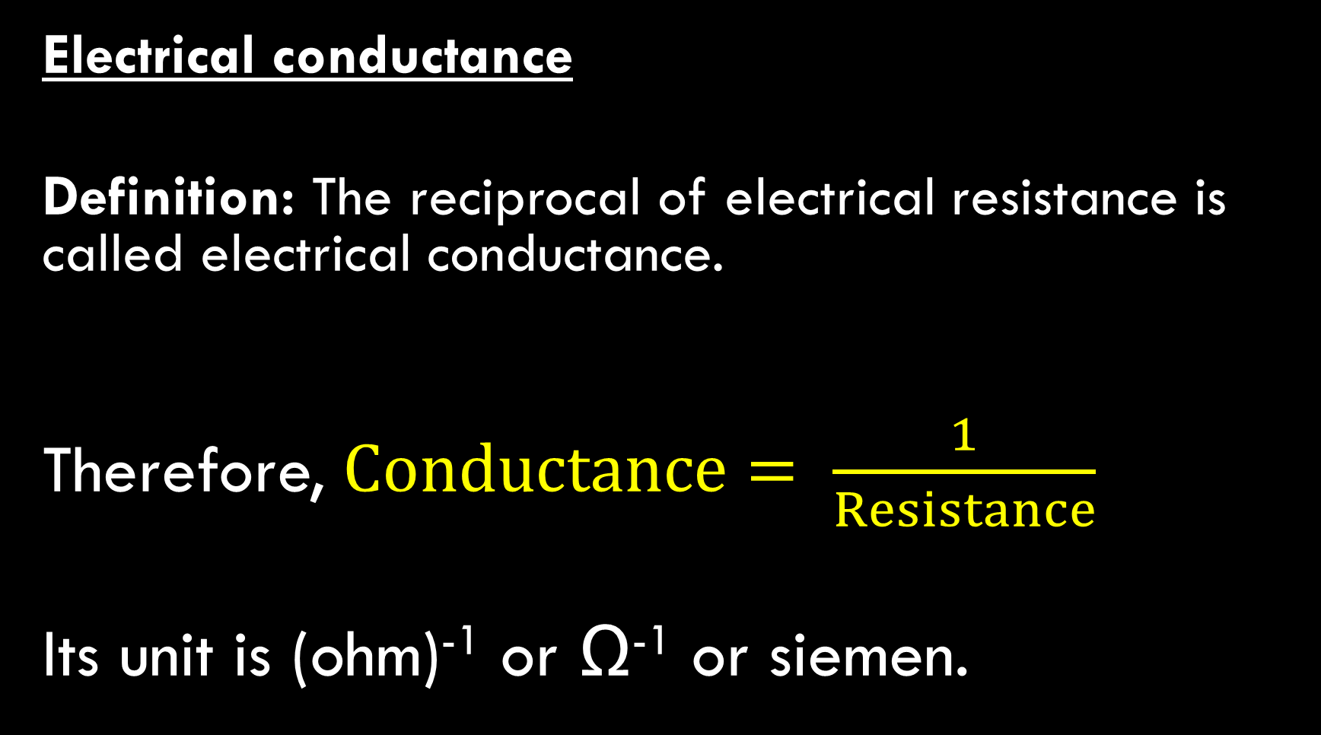
Electrical conductance
Definition: The reciprocal of electrical resistance is called electrical conductance.
Therefore, $Conductance= \frac{1}{Resistance}$
Its unit is (ohm)⁻¹ or Ω⁻¹ or siemen.

Slide 9
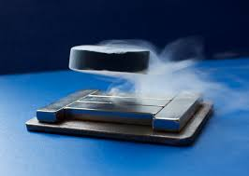
Superconductors:
The resistance of some substances decrease tremendously with the decrease in temperature in the very low temperature range (i.e. near absolute zero)
The substances under this condition are called superconductors.
The resistance of a superconductor is almost zero in the very low temperature range.
Once a current is set up in a superconductor, the current will persist without any voltage applied i.e. the conductivity of the superconductor is infinite.
Definition: A superconductor is a substance of zero resistance at a very low temperature.
Example: The resistance of mercury at 4.2 K is zero.

Slide 10
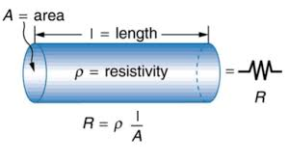
Factors affecting resistance
Length of Conductor
Area of cross-section of conductor (or thickness of the conductor).
Nature of the material of the conductor, and
Temperature of the conductor.

Slide 11
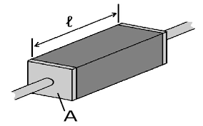
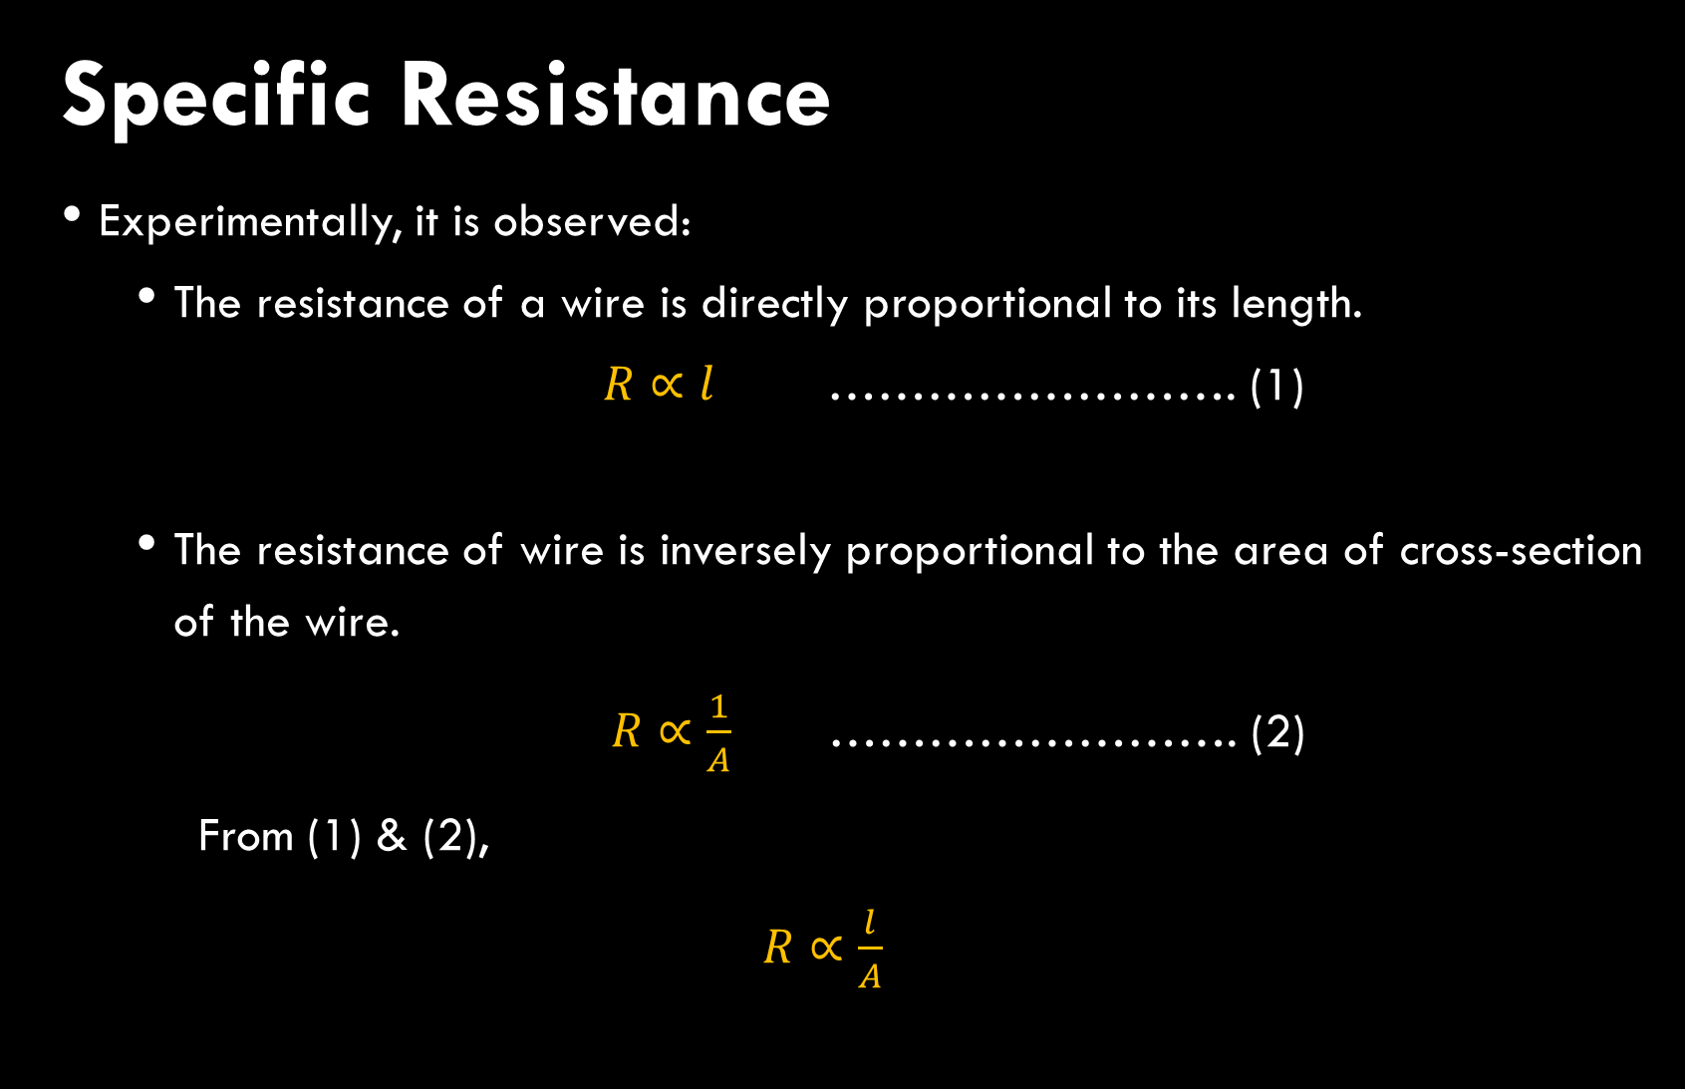
Specific Resistance
Experimentally, it is observed:
The resistance of a wire is directly proportional to its length.
$R∝l$ ……………………. (1)
The resistance of wire is inversely proportional to the area of cross-section of the wire.
$R∝\frac{1}{A}$ ……………………. (2)
From (1) & (2),
$R∝\frac{l}{A}$

Slide 12
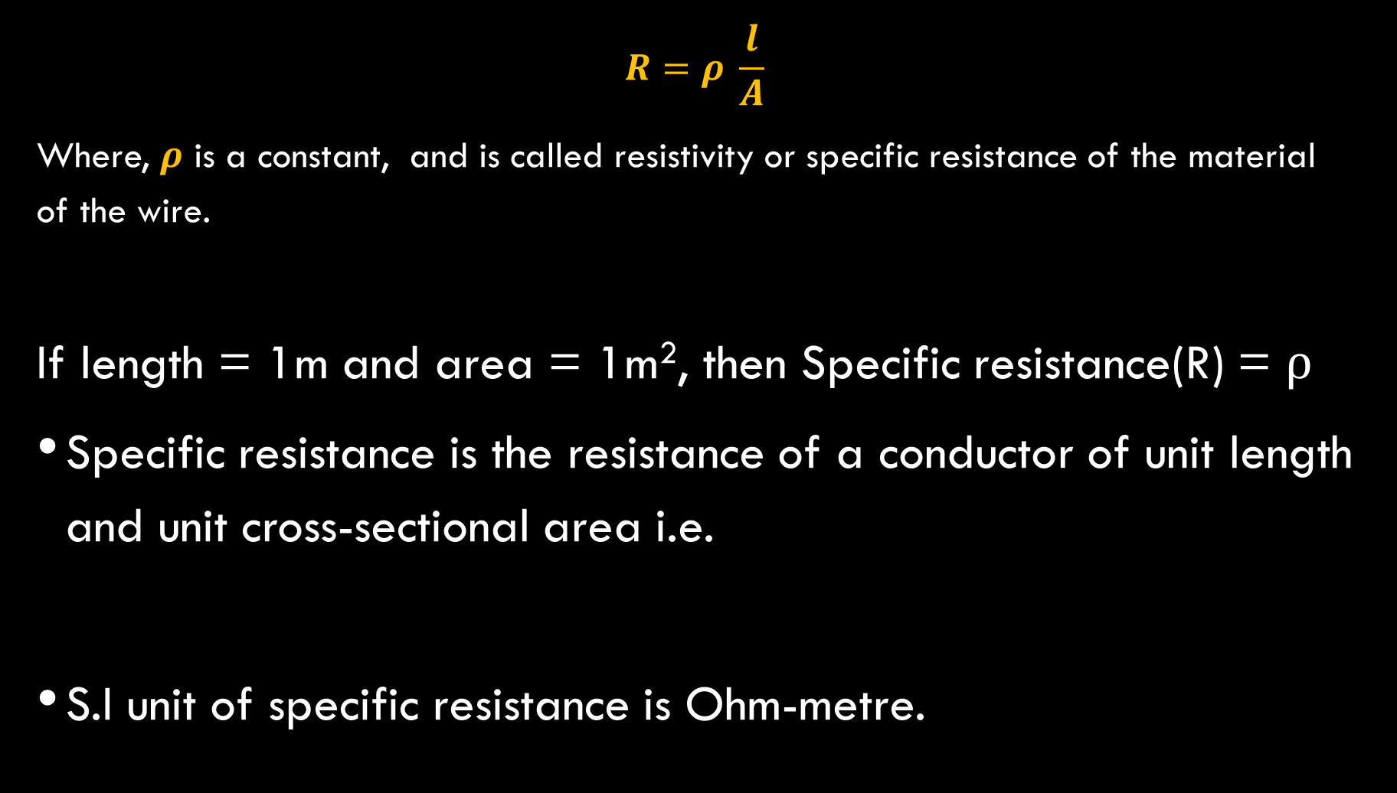
$$R=ρ \frac{l}{A}$$
Where, $ρ$ is a constant, and is called resistivity or specific resistance of the material of the wire.
If length = 1m and area = 1m², then Specific resistance(R) = $ρ$
Specific resistance is the resistance of a conductor of unit length and unit cross-sectional area i.e.
S.I unit of specific resistance is Ohm-metre.

Slide 13
Variation of resistance and resistivity with temperature.
For a metallic conductor, the resistance and resistivity increases with increase in temperature.
For alloys (constantan and manganine), the resistance ad resistivity remains practically unchanged with the increase in temperature.
For semiconductors (such silicon, germanium), the resistance decreases with decrease in temperature.

Slide 14
Thank you

